Slide 1
Arduino Basics
Ардуино осноВИ
Част 5
gevelichkov@gmail.com

Slide 2
Съдържание
Фоторезистор
Команда Random
RGB Светодиод
Транзистори
Активен бъзер
Пасивен бъзер
Домашна работа

Slide 3
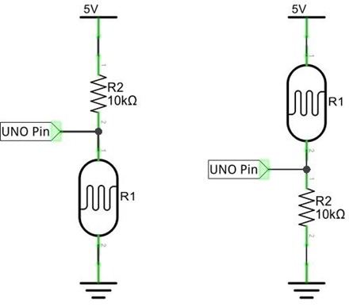
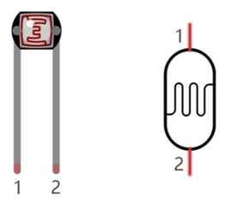
Фоторезистор и схема на свързване

Slide 4
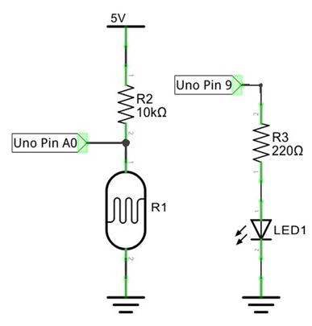
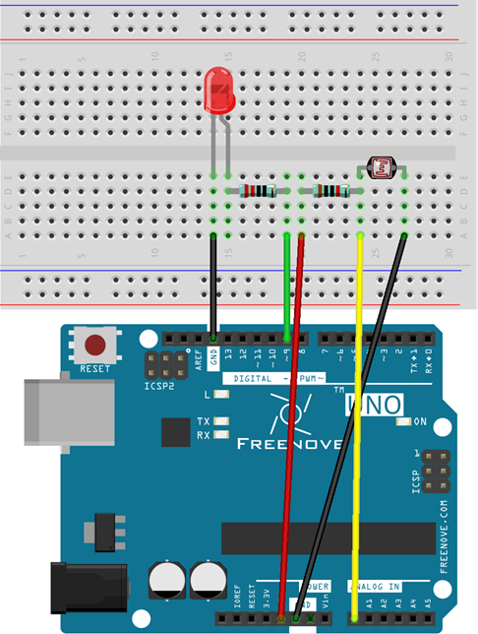
Фоторезистор задача 1

Slide 5
Код на задача 1
int convertValue; // Define a variable to save the ADC value int
ledPin = 9; // The number of the LED pin
void setup() {
pinMode(ledPin, OUTPUT); // Set ledPin into output mode
}
void loop() {
convertValue = analogRead(A0); // Read analog voltage value of A0 port, and save
// Map analog to the 0-255 range, and works as ledPin duty cycle setting
analogWrite(ledPin, map(convertValue, 0, 1023, 0, 255));
}

Slide 6
RAndom
Решаване проблема с генериране на случайни числа
random(Max);
random(Min, Max);
random(10, 20);
Тип данни: long

Slide 7

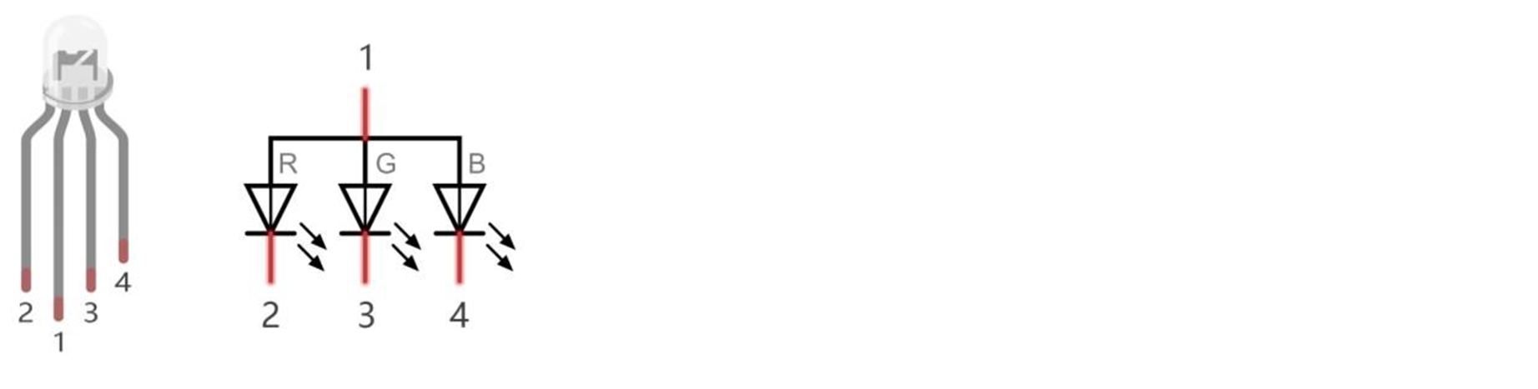
Rgb светодиод

Slide 8
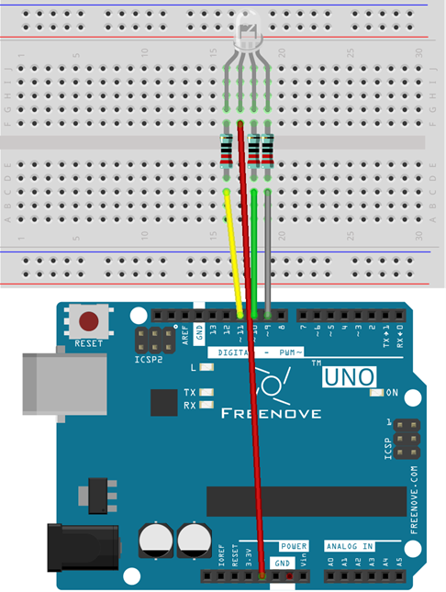
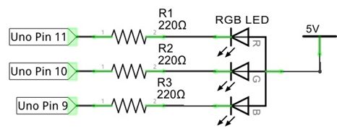
Свързване на RGB светодиод, задача 2

Slide 9
Код задача 2
int ledPinR = 11; // the number of the LED Red pin
int ledPinG = 10; // the number of the LED Green pin
int ledPinB = 9; // the number of the LED Blue pin
void setup() {
// initialize the LED pin as an output:
pinMode(ledPinR, OUTPUT);
pinMode(ledPinG, OUTPUT);
pinMode(ledPinB, OUTPUT);
}
void loop() {
// Generate three random numbers between 0-255 as the output PWM duty cycle of ledPin
rgbLedDisplay(random(256), random(256), random(256));
delay(500);
}
void rgbLedDisplay(int red, int green, int blue) {
// Set three ledPin to output the PWM duty cycle
analogWrite(ledPinR, constrain(red, 0, 255));
analogWrite(ledPinG, constrain(green, 0, 255));
analogWrite(ledPinB, constrain(blue, 0, 255));
}

Slide 10
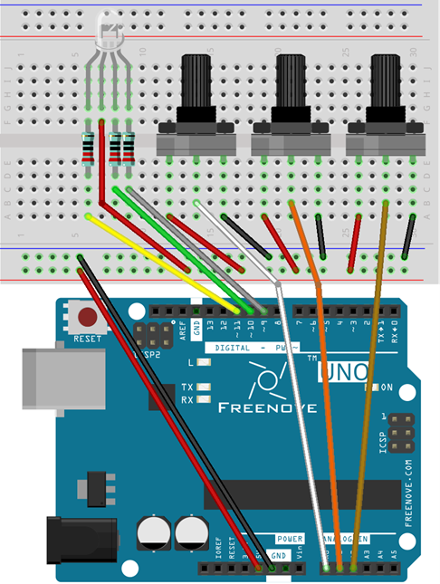
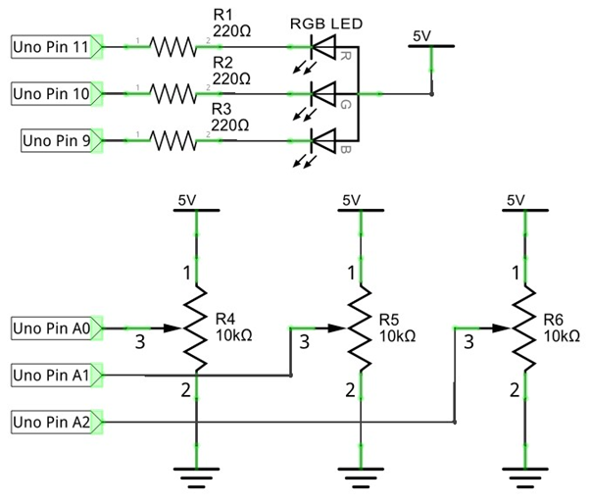
RGB светодиод с шим на всеки цвят, задача 3

Slide 11
Код задача 3
// set pin numbers:
int ledPinR = 11; // the number of the LED R pin
int ledPinG = 10; // the number of the LED G pin
int ledPinB = 9; // the number of the LED B pin
void setup() {
// initialize the LED pin as an output:
pinMode(ledPinR, OUTPUT);
pinMode(ledPinG, OUTPUT);
pinMode(ledPinB, OUTPUT);
}
void loop() {
int adcValue; // Define a variable to save the ADC value
// Convert analog of A0 port into digital, and work as PWM duty cycle of ledPinR port
adcValue = analogRead(A0);
analogWrite(ledPinR, map(adcValue, 0, 1023, 0, 255));
// Convert analog of A1 port into digital, and work as PWM duty cycle of ledPinG port
adcValue = analogRead(A1);
analogWrite(ledPinG, map(adcValue, 0, 1023, 0, 255));
// Convert analog of A2 port into digital, and work as PWM duty cycle of ledPinB port
adcValue = analogRead(A2);
analogWrite(ledPinB, map(adcValue, 0, 1023, 0, 255));
}

Slide 12
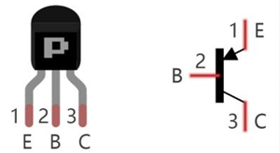
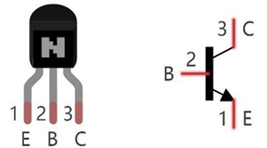
Транзистор
PNP transistor, 8550 is PNP NPN transistor, 8050 is NPN

Slide 13
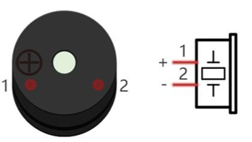
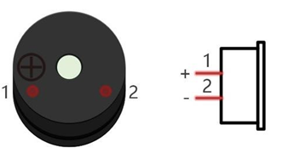
Аудио Бъзер, активен и пасивен
Active buzzer Passive buzzer

Slide 14
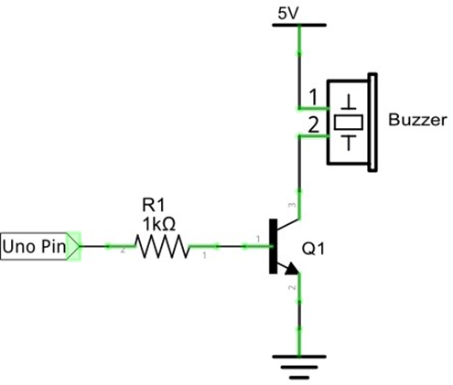
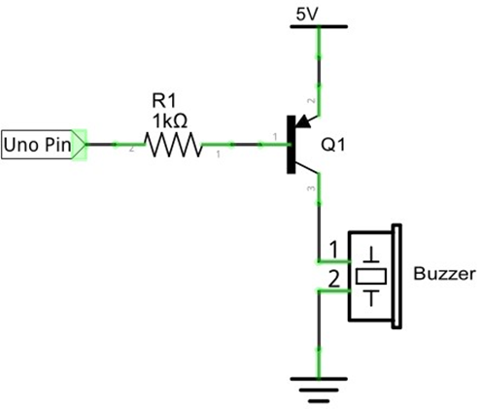
Схема на свързване на транзистор и Бъзер

Slide 15
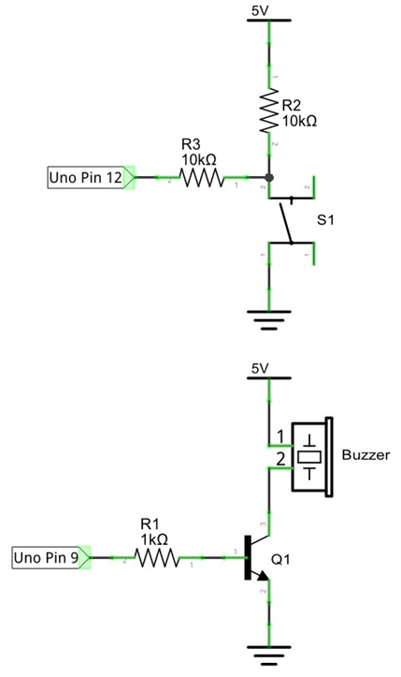
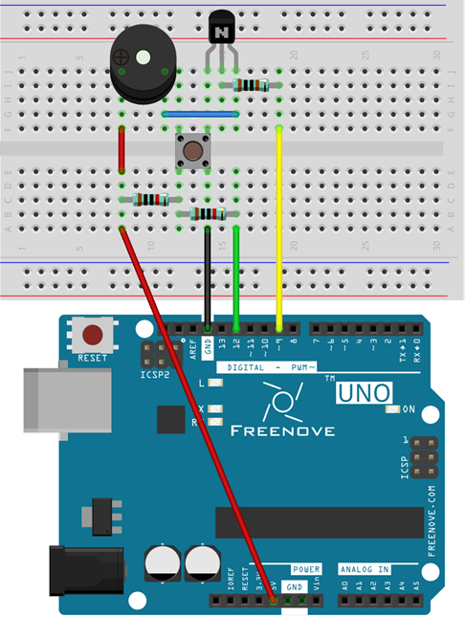
Активен Бъзер, задача 4

Slide 16
Код задача 4
int buttonPin = 12; // the number of the push button pin
int buzzerPin = 9; // the number of the buzzer pin
void setup() {
pinMode(buttonPin, INPUT); // Set push button pin into input mode
pinMode(buzzerPin, OUTPUT); // Set Buzzer pin into output mode
}
void loop() {
if (digitalRead(buttonPin) == HIGH)// If the pin is high level, the button is not pressed.
digitalWrite(buzzerPin, LOW); // Turn off Buzzer
else
// The button is pressed, if the pin is low level
digitalWrite(buzzerPin, HIGH); // Turn on Buzzer
}

Slide 17
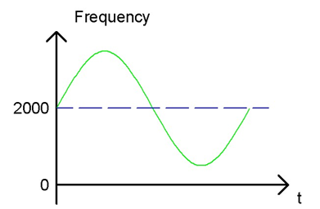
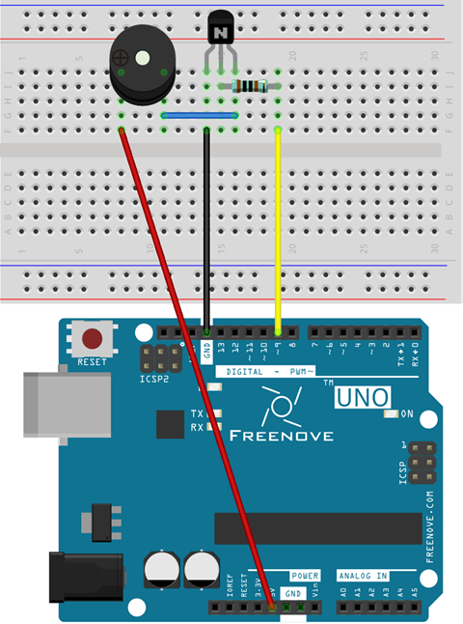
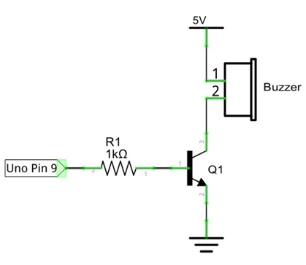
Пасивен бъзер, Задача 5

Slide 18
Код задача 5
int buzzerPin = 9; // the number of the buzzer pin
float sinVal; // Define a variable to save sine value
int toneVal; // Define a variable to save sound frequency
void setup() {
pinMode(buzzerPin, OUTPUT); // Set Buzzer pin to output mode
}
void loop() {
for (int x = 0; x < 360; x++) { // X from 0 degree->360 degree
sinVal = sin(x * (PI / 180)); // Calculate the sine of x
toneVal = 2000 + sinVal * 500; // Calculate sound frequency according to the sine of x
tone(buzzerPin, toneVal); // Output sound frequency to buzzerPin
delay(1);
}
}

Slide 19
Бонус код към задача 5
Запазвате свързването и поставяте кода от линка:
https://gist.github.com/nicksort/4736535

Slide 20
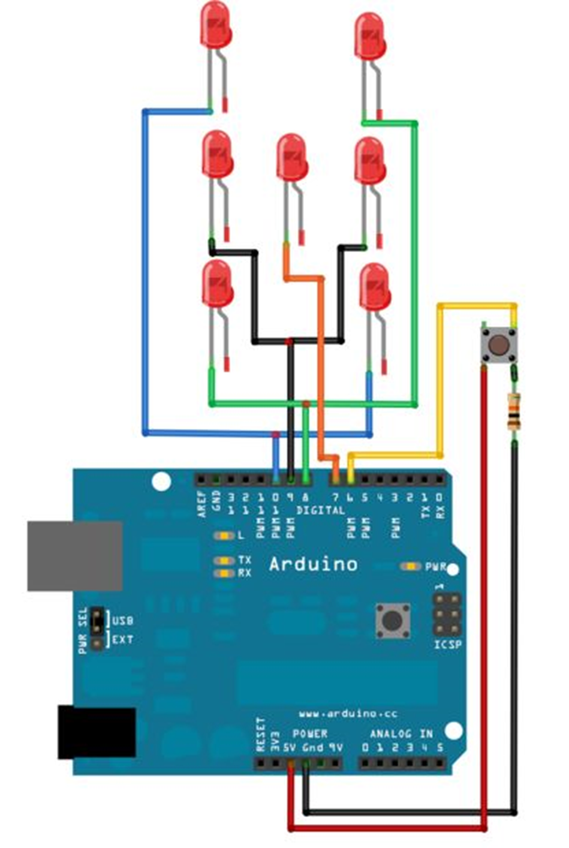
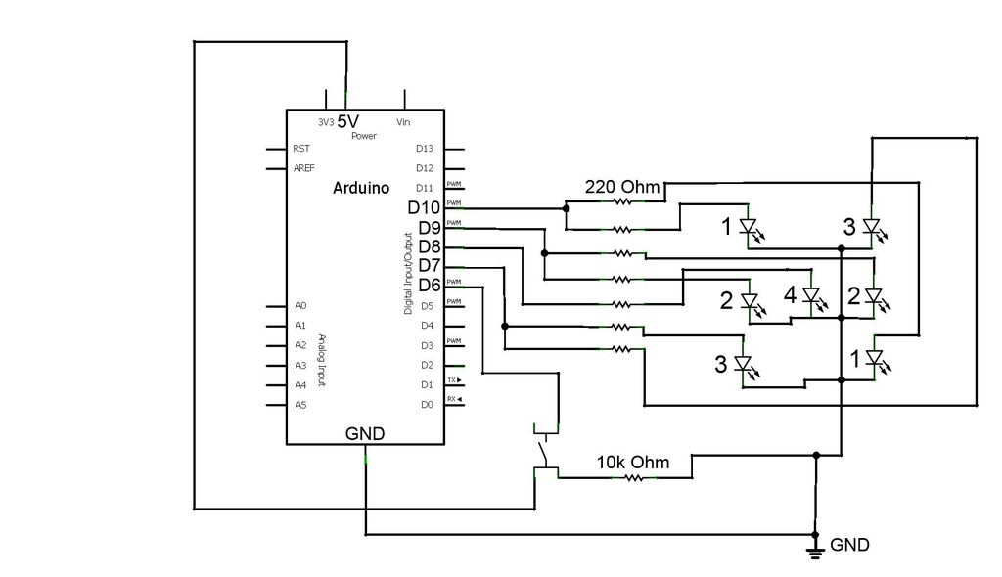
Бонус задача към комaнда random
Електронно зарче

Slide 21
Код към задача електронно зарче
int pinLeds1 = 10;
int pinLeds2 = 9;
int pinLeds3 = 7;
int pinLed4 = 8;
int buttonPin = 6;
int buttonState;
long ran;
int time = 2000;
void setup (){
pinMode (pinLeds1, OUTPUT);
pinMode (pinLeds2, OUTPUT);
pinMode (pinLeds3, OUTPUT);
pinMode (pinLed4, OUTPUT);
pinMode (buttonPin, INPUT);
randomSeed(analogRead(0));
}
void loop() {
buttonState = digitalRead(buttonPin);
if (buttonState == HIGH){
ran = random(1, 7);
if (ran == 1){
digitalWrite (pinLed4, HIGH);
delay (time);
}
if (ran == 2){
digitalWrite (pinLeds1, HIGH);
delay (time);
}
if (ran == 3){
digitalWrite (pinLeds3, HIGH);
digitalWrite (pinLed4, HIGH);
delay (time);
}
if (ran == 4){
digitalWrite (pinLeds1, HIGH);
digitalWrite (pinLeds3, HIGH);
delay (time);
}
if (ran == 5){
digitalWrite (pinLeds1, HIGH);
digitalWrite (pinLeds3, HIGH);
digitalWrite (pinLed4, HIGH);
delay (time);
}
if (ran == 6){
digitalWrite (pinLeds1, HIGH);
digitalWrite (pinLeds2, HIGH);
digitalWrite (pinLeds3, HIGH);
delay (time);
}
}
digitalWrite (pinLeds1, LOW);
digitalWrite (pinLeds2, LOW);
digitalWrite (pinLeds3, LOW);
digitalWrite (pinLed4, LOW);
}

Slide 22

Поздравления ! ! ! вече сте пет крачкИ напред ;)

Slide 23
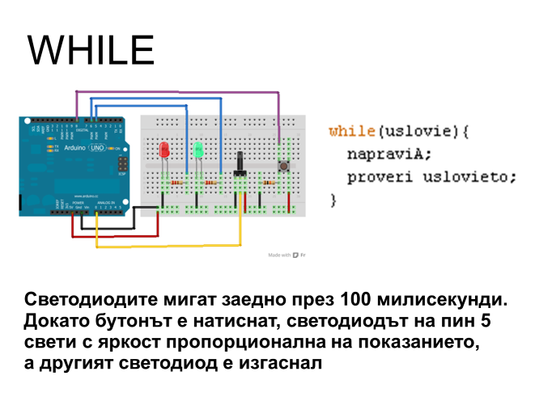
Домашна работа

Slide 24
ПРавила за безопасност ! ! !

